Slide 1
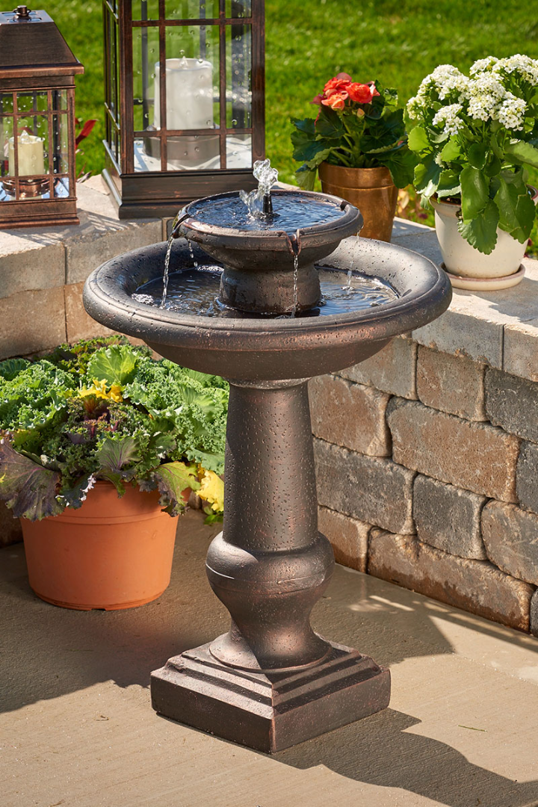
Smart Water Fountains using IOT
Upgrade your water fountains with the internet of things for a smarter, more sustainable future.
Notes:
1

Slide 2
What are smart water fountains?
Sustainable 🌱
User-Friendly 🙌
Cost-effective 💰
Designed with eco-friendly materials and sensors that track water usage, smart water fountains help reduce waste and conserve water resources.
Intuitive interfaces make it easy to find and use the water fountain. Plus, real-time data on water quality keeps users informed of potential risks.
Save money on utilities and maintenance costs by automatically tracking usage data and detecting malfunctions before they occur.
Notes:
2

Slide 3
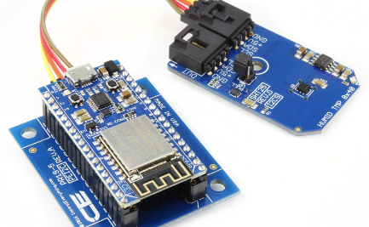
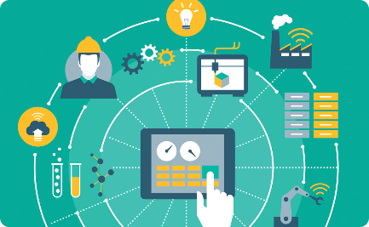
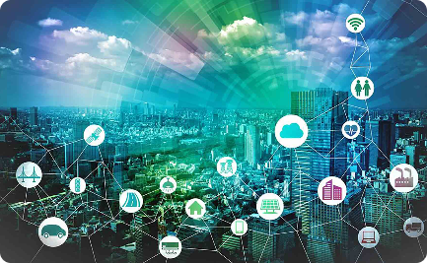
The benefits of integrating IOT
Data Collection 📊
Remote Monitoring 🌍
Smart Control 🤖
Real-time data collection helps monitor water usage and detects potential malfunctions, reducing water waste and operational costs.
Use remote monitoring and predictive maintenance to detect issues before they occur, and keep repair costs down.
Integrate iot connectivity to allow for remote control of fountains, enabling easy management and monitoring.
Notes:
3

Slide 4
Features of smart water fountains
Smart Sensors
Track usage data and detect potential malfunctions in real-time for better efficiency and cost savings.
Touchless Controls
2
Improve sanitation and reduce the spread of germs with touchless controls and automatic dispensing.
3
Water Quality Monitoring
Track water quality and detect potential hazards before they become an issue with smart sensors and real-time data collection.
Notes:
4

Slide 5

How IOT is integrated
Smart Sensors and Controls
2
Data Analysis
3
Cloud Connectivity
Data analysis tools can provide real-time insights into usage patterns and maintenance requirements, saving time and reducing costs.
Integrating sensors and controls into traditional hardware enables real-time data collection and remote management via the internet of things.
Connecting fountains to the cloud allows for easy management and monitoring of multiple locations from a single platform.
Notes:
5

Slide 6

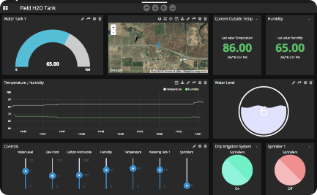
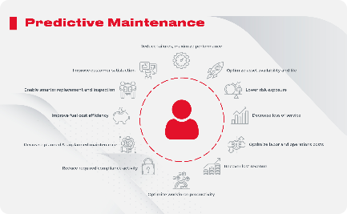
Data collection and analysis
Dashboard Reporting
Predictive Maintenance
Usage Analytics
Track usage patterns and analyze data on water consumption, temperature, and sanitation to improve operating efficiencies and reduce costs.
Use data analysis tools to identify potential issues before they become major problems, and provide predictive maintenance to keep fountains running smoothly.
View data in real-time via a customizable dashboard interface, providing insights into performance metrics and usage patterns.
Notes:
6

Slide 7
Impact on environment and cost
Environmental Impact ♻️
Reduce water waste and environmental impact with water conservation and eco-friendly materials, while also increasing the lifespan of fountain hardware and reducing waste.
Cost Savings 💰
2
Save money on utilities and maintenance costs by using real-time data collection and predictive maintenance to detect malfunctions before they become costly problems.
3
Improved User Experience 👍
Boost user satisfaction with touchless controls, water quality monitoring, and improved operational efficiency, leading to increased productivity and overall satisfaction.
Notes:
7

Slide 8
Conclusion and future possibilities
Improved Sustainability 🌱
Increased Cost Savings 💸
Future Innovations 🚀
The possibilities for smart water fountains remain endless, including real-time usage analytics and cloud-connected monitoring.
By using smart water fountains and iot technology, we can continue to improve sustainability and reduce environmental impact across various industries, from parks to schools to corporate campuses.
Real-time data collection and predictive maintenance provide the opportunity to reduce operational costs and improve bottom-line growth.
Notes:
8

Slide 9

Blueprint for Smart Water Fountains
Smart water fountains are a new and innovative approach to traditional drinking fountains. They use advanced technology to monitor water quality in real-time, provide customizable water temperature options, and can be integrated with smart devices. They offer many advantages over traditional fountains and have the potential to revolutionize our public spaces.

Slide 10
Benefits of Smart Water Fountains
Encouraging Hydration and Improving Public Health
2
Reducing Water Wastage and Promoting Sustainability
3
Enhancing User Experience with Advanced Features
Smart water fountains can be customized to include additional features, such as hydration tracking and reminders, bottle filling stations, and accessibility options.
Smart water fountains can provide clean and safe drinking water to everyone, promoting healthy hydration habits. They can also monitor water quality to ensure it is safe for consumption.
Smart water fountains can be designed to reduce water wastage and environmental impact. They can be integrated with sensors and timers to control water flow and detect leaks.

Slide 11
Key Features of Smart Water Fountains
Customizable Water Temperature Options
Integration with Smart Devices for User Convenience
Real-Time Monitoring of Water Quality
Smart water fountains can be integrated with smart devices, such as phones and watches, to provide a more convenient user experience. This can include features such as automatic filling or reminders to drink more water.
Smart water fountains can monitor water quality in real-time to ensure safe and clean drinking water. Sensors can detect contaminants and send alerts if there are any issues.
Smart water fountains can offer customizable water temperature options, including hot, cold, and ambient temperatures. This can provide a more pleasant drinking experience for users.

Slide 12
Installation and Maintenance
Smart water fountains require specific installation and maintenance procedures to ensure optimal performance and safety.
Steps for Installing Smart Water Fountains
Assessing the location and ensuring proper plumbing and electrical connections.
Preparing the installation site and mounting the fountain.
Connecting the water and power supply.
Testing the system and ensuring proper operation.
Regular Maintenance and Cleaning Procedures
Regularly cleaning the fountain to prevent bacterial growth.
Replacing any worn or damaged components.
Testing and calibrating sensors and other technology.
Troubleshooting Common Issues
Common issues can include leaks, low water pressure, and component failure.
Ensuring immediate repairs can prevent more significant problems and damage.

Slide 13
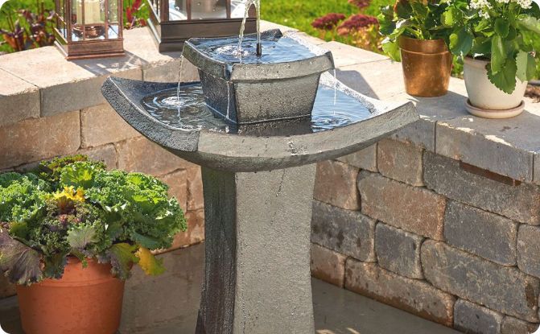
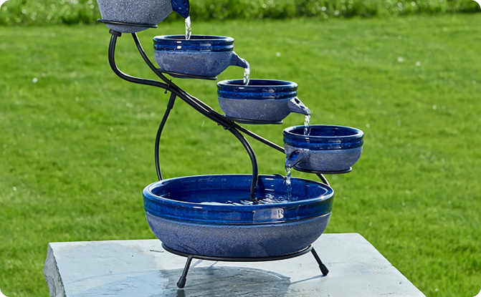
Case Studies
Successful Implementation of Smart Water Fountains in Urban Areas
Positive Impact on Water Consumption Patterns and User Satisfaction
Many cities have successfully implemented smart water fountains in their public spaces, improving access to clean drinking water and promoting sustainability.
Studies have shown that smart water fountains can change water consumption patterns and increase user satisfaction with public drinking fountains.

Slide 14
Future Developments and Challenges
Potential Advancements in Smart Water Fountain Technology
2
Addressing Security and Privacy Concerns
3
Overcoming Financial and Logistical Barriers
Smart water fountains collect and store sensitive data, requiring careful consideration of security and privacy concerns.
Implementation of smart water fountains requires significant financial investment and logistical planning, which can present barriers to more widespread adoption.
Advancements in technology could improve water quality monitoring, enhance customizable features, and improve user convenience.

Slide 15
Conclusion
Summarizing the Benefits and Potential of Smart Water Fountains
Encouraging Wider Adoption and Integration in Public Spaces
Smart water fountains provide safe and clean drinking water while promoting sustainability and user convenience.
As technology continues to advance, we hope to see more widespread adoption of smart water fountains in public spaces.

Slide 16
import random
import time
import paho.mqtt.client as mqtt
# Simulated sensor data (replace with real sensor readings)
def get_water_level():
return random.uniform(0.0, 100.0)
def get_temperature():
return random.uniform(0.0, 40.0)
def get_ph_level():
return random.uniform(0.0, 14.0)
# MQTT Settings
broker_address = "mqtt.eclipse.org"
port = 1883
topic = "smart_water_foundation"
# Create a MQTT client
client = mqtt.Client()
# Connect to the broker
client.connect(broker_address, port)
PROGRAM

Slide 17
try:
while True:
# Get sensor data
water_level = get_water_level()
temperature = get_temperature()
ph_level = get_ph_level()
# Create JSON payload
payload = {
"water_level": water_level,
"temperature": temperature,
"ph_level": ph_level
}
# Publish data to the broker
client.publish(topic, str(payload))
# Print for debugging (optional)
print(f"Published: {payload}")
# Delay for a while (adjust as needed)
time.sleep(10) # e.g., every 10 seconds
except KeyboardInterrupt:
client.disconnect()

Slide 18
OUTPUT
Published: {'water_level': 43.765681607967534, 'temperature': 35.28613649094769, 'ph_level': 2.834535224079818}
These lines indicate that the script has generated simulated sensor data and published it tothe MQTT broker. The data is in the form of a dictionary containing water level, temperature, and pH level readings.
These values are random in this example, but in a real-world application, they would be coming from actual sensors.

Slide 19
END

